Slide 1
The 1960s :
British Invasion
And
Motown

Slide 2
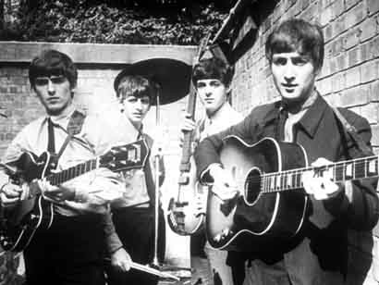
The Beatles

Slide 3
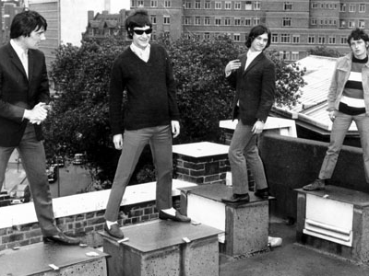
The Kinks

Slide 4
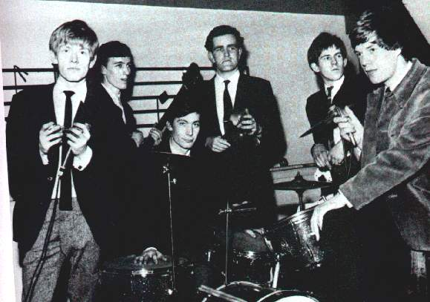
The Rolling Stones

Slide 5
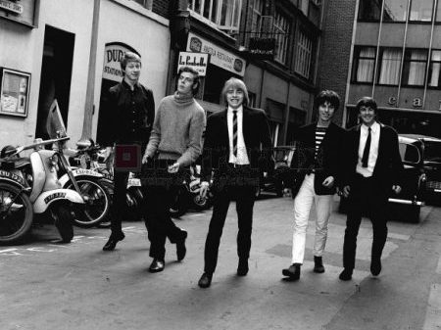
The Yardbirds

Slide 6
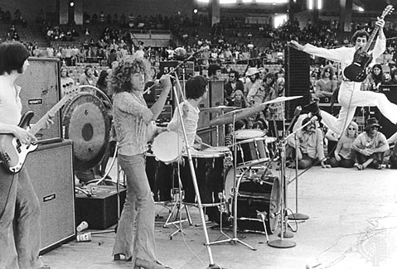
The Who

Slide 7
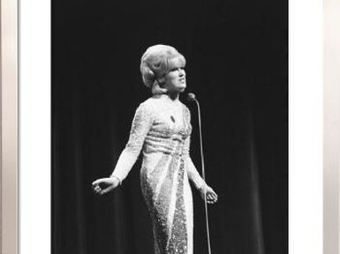
Dusty Springfield

Slide 8
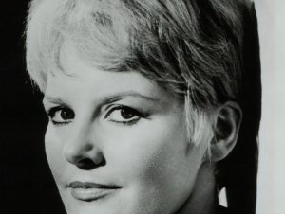
Petula Clark

Slide 9
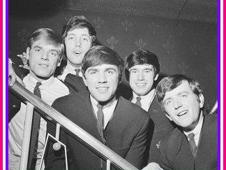
Dave Clark Five

Slide 10
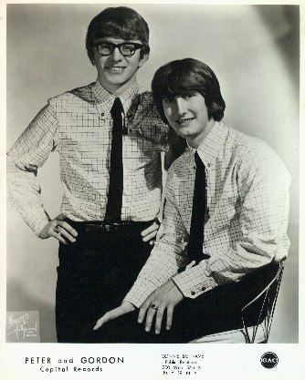
Peter and Gordon

Slide 11
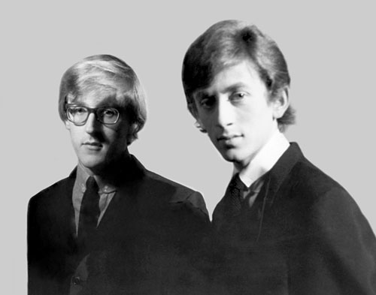
Chad and Jeremy

Slide 12
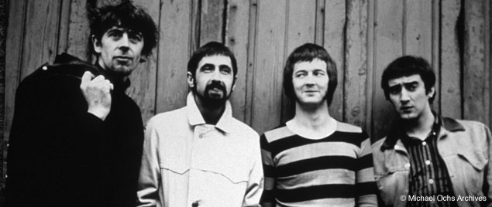
John Mayall and the Bluesbreakers

Slide 13
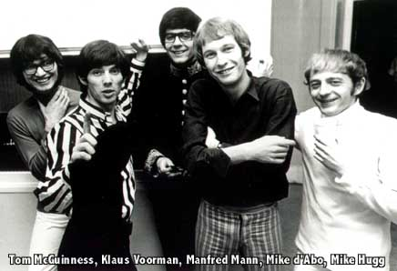
Manfred Mann

Slide 14
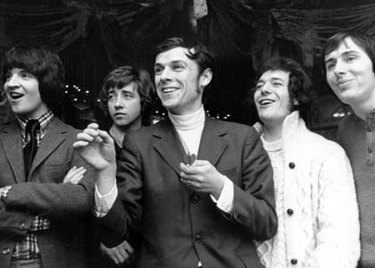
The Hollies

Slide 15
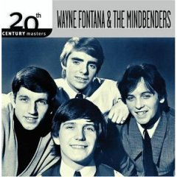
Wayne fontana and the Mindbenders

Slide 16
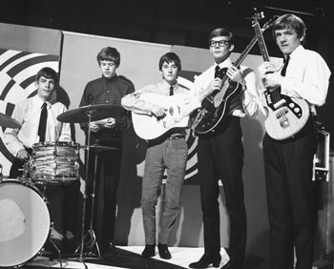
Herman’s Hermits

Slide 17
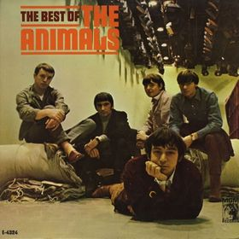
The Animals

Slide 18
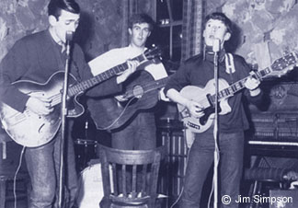
The Spencer-Davis Group

Slide 19
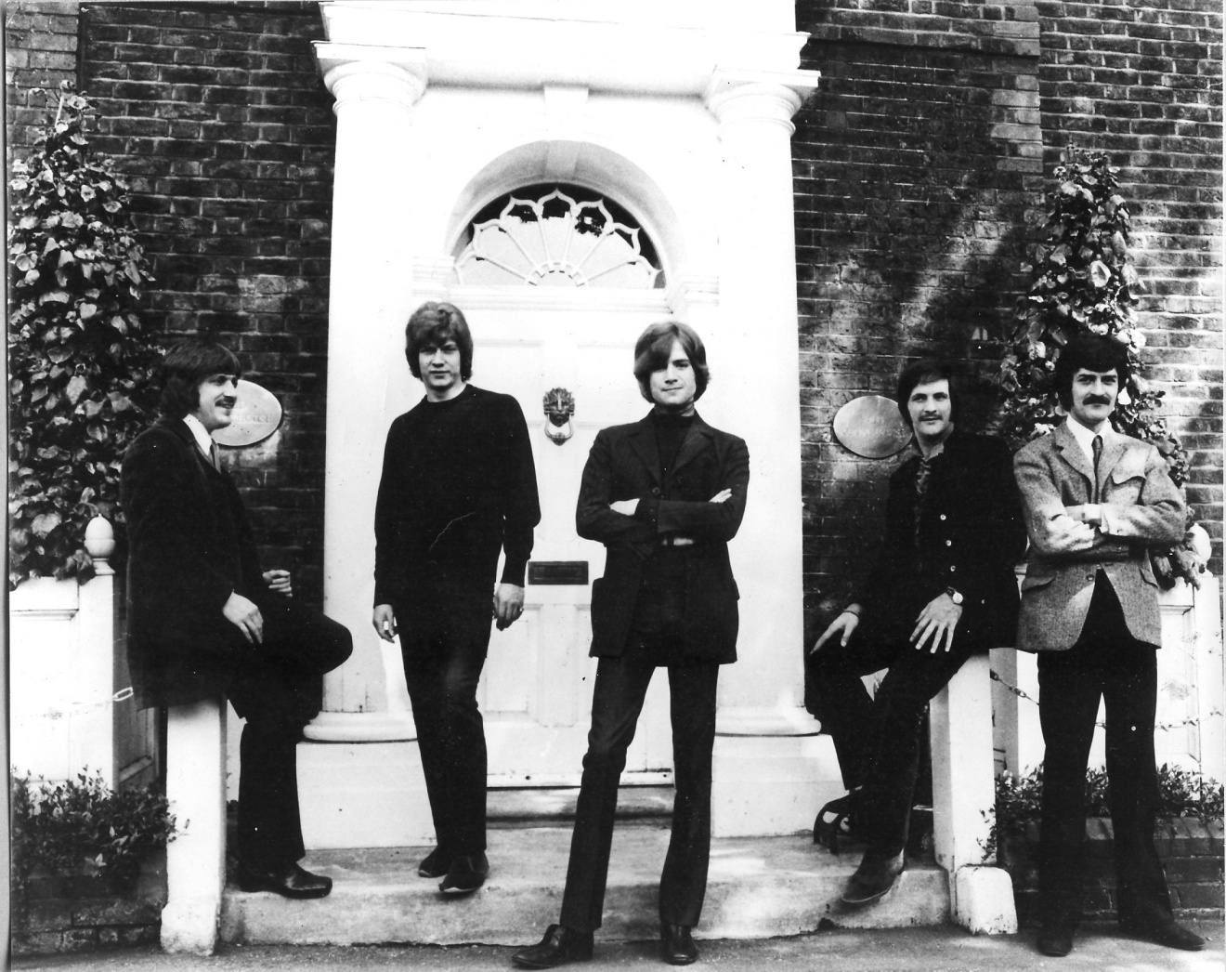
The Moody Blues

Slide 20
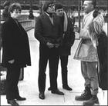
Them

Slide 21
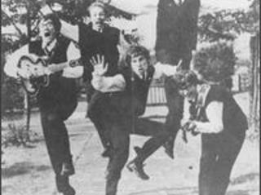
The Zombies

Slide 22
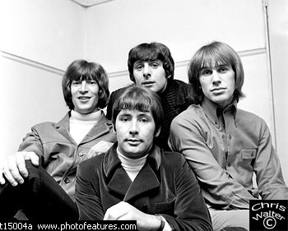
The Troggs

Slide 23
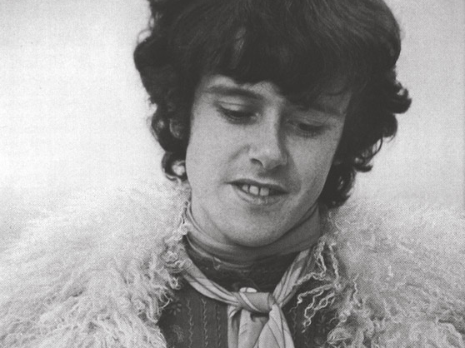
Donovan

Slide 24
Stars of the
Motown Sound

Slide 25
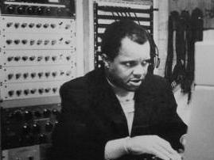
Motown’s Founder Barry Gordy

Slide 26
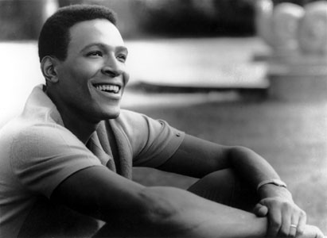
Marvin Gaye

Slide 27
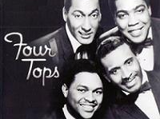
The Four Tops

Slide 28
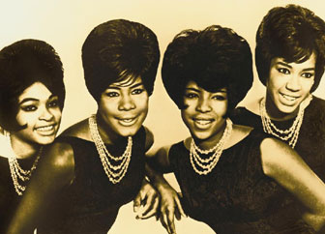
The Marvelettes

Slide 29
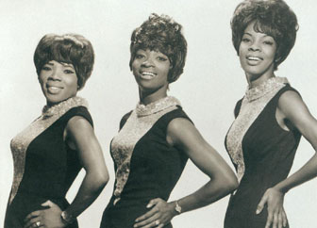
Martha and the Vandellas

Slide 30
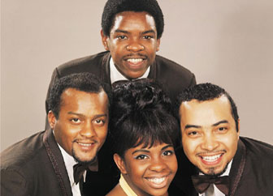
Gladys Knight and the Pips

Slide 31
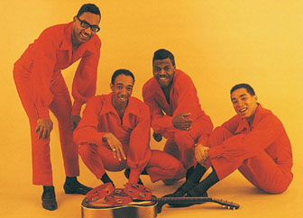
Smokey Robinson and the Miracles

Slide 32
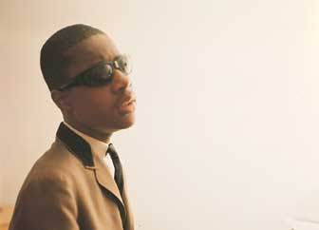
Stevie Wonder

Slide 33
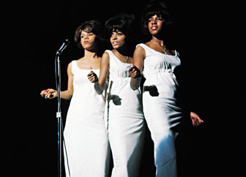
Diana Ross and the Supremes

Slide 34
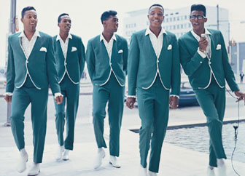
The Temptations

Slide 35
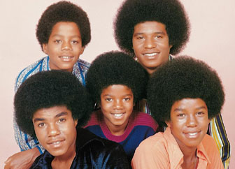
The Jackson Five

