Slide 1
Assimilation-teach them the white culture
Dawes Act- broke up reservation land into private allotments. Each N.A. family would receive a plot of land.
What was this suppose to accomplish?
1. This would help N.A. to become farmers
2. This would break up the tribal traditions of
the N.A. , thus helping them to become a part
of “White culture”
What actually happened-most N.A. sold their land to whites because they did not want to give up their tribal traditions. Most whites swindled the N.A. during these land sales.

Slide 2
Assimilation-Teach them white Culture
How? Send them to “white schools”
Two Types of “white schools”
1. Schools on Reservation taught by whites
2. Boarding schools
Why send them to white schools?
White perspective-Kill the N.A. culture, and totally immerse them into white culture
Native perspective- Give their children a chance in the white man’s world

Slide 3
Carlisle Indian School-Pennsylvania
This is an example of a boarding school Natives sent their children to.
Many never saw their children again.
Many students left these schools feeling like they did not indentify with either their native families or the whites.

Slide 4
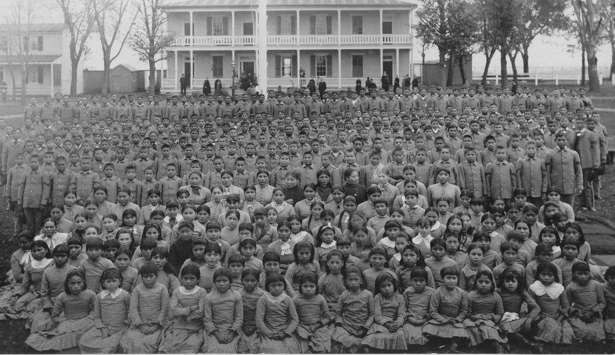
Carlisle School

Slide 5
Colonel Richard Pratt-(founder)

Slide 6
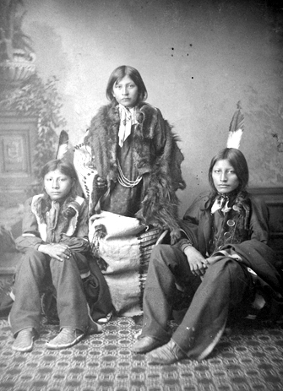

Slide 7
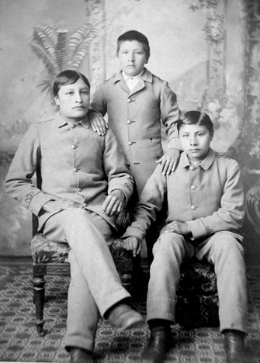

Slide 9
