Slide 1
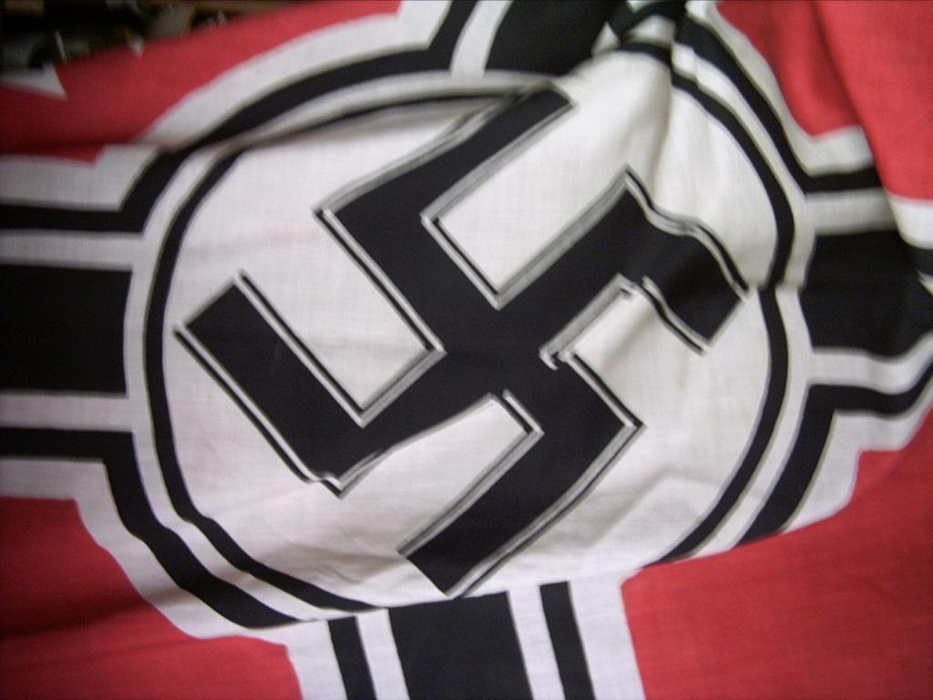
Portraits of hitler
Holocaust Studies

Slide 2
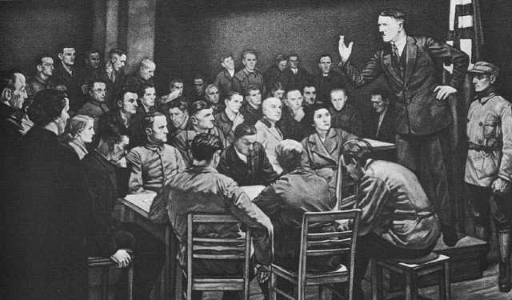
This widely distributed print by Hoyer was titled “In the Beginning was the Word,” a clear reference to the opening of the biblical Gospel of John.

Slide 4
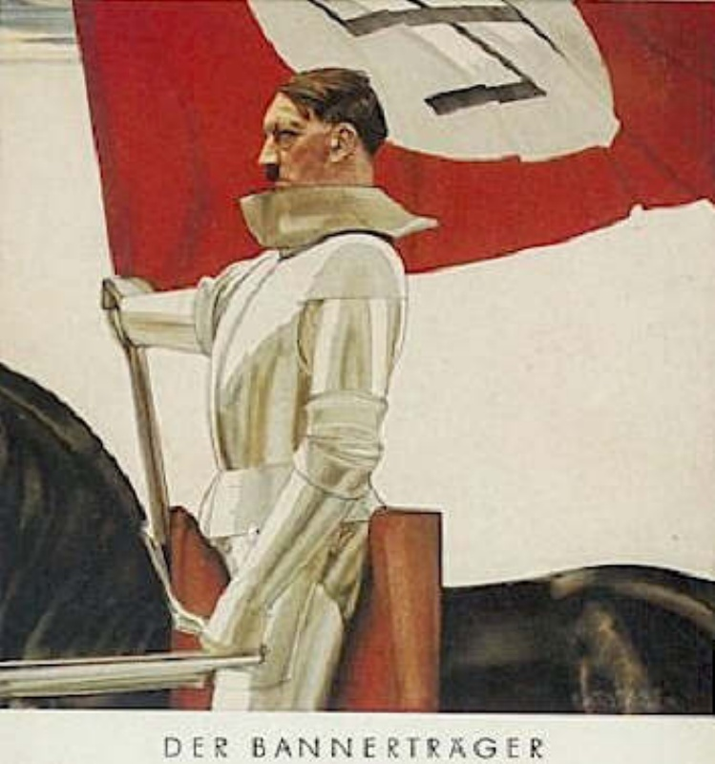

Slide 5
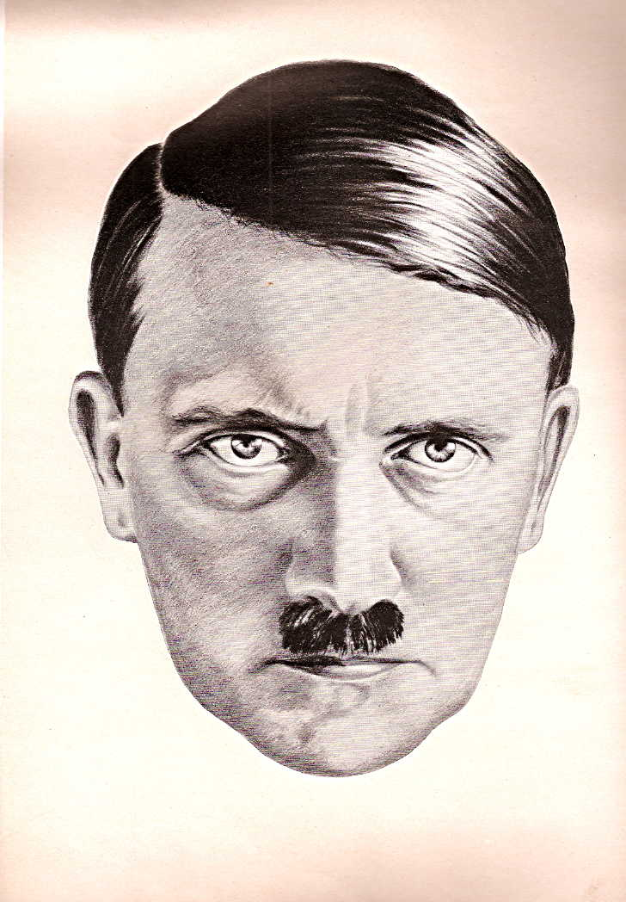
This rather striking drawing is by H. Oloffs, based on a Hoffmann photograph, and is the frontpiece to Hans Heinz Mantau-Sadila, Deutsche Führer Deutsches Schicksal: Das Buch der Künder und Führer des dritten Reiches (Berlin: Verlag und Versand für Deutsche Literatur Hans Eugen Hummel, 1934).

Slide 6
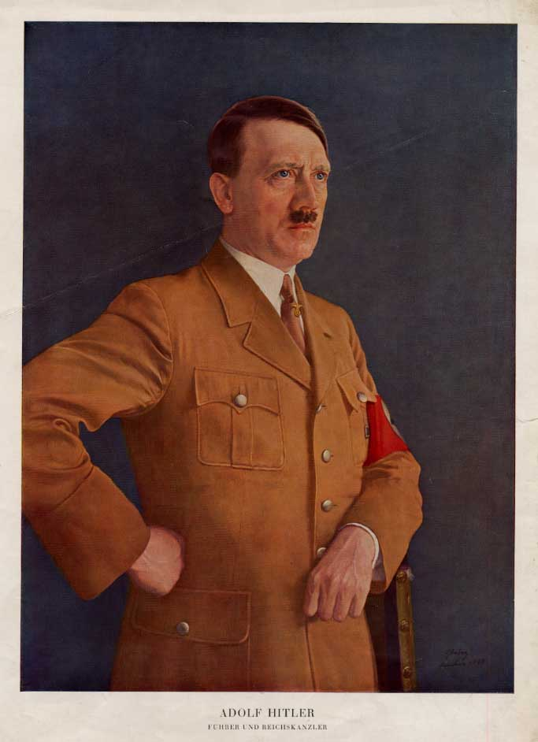
This widely distributed 1935 portrait is by Heinrich Knirr.

Slide 7
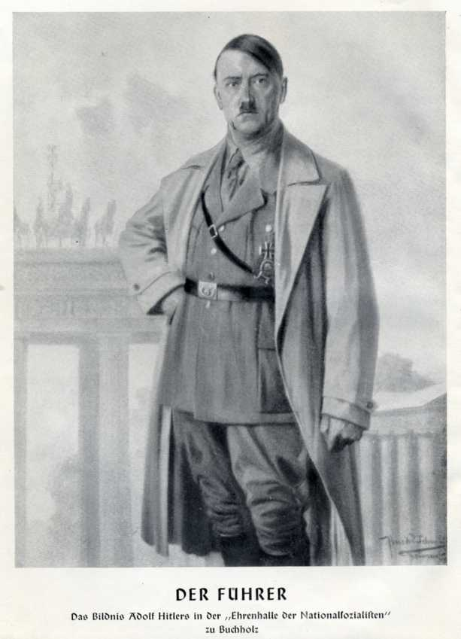
This painting hung in a memorial museum of Nazi history in Buchholz, a town near Hannover. The artist is listed as Professor Schmidt-Weimar.

Slide 8
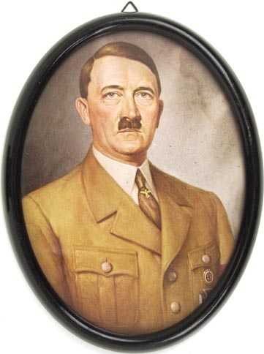
This is an example of the mass-produced Hitler pictures that people could hang in their homes.

Slide 9
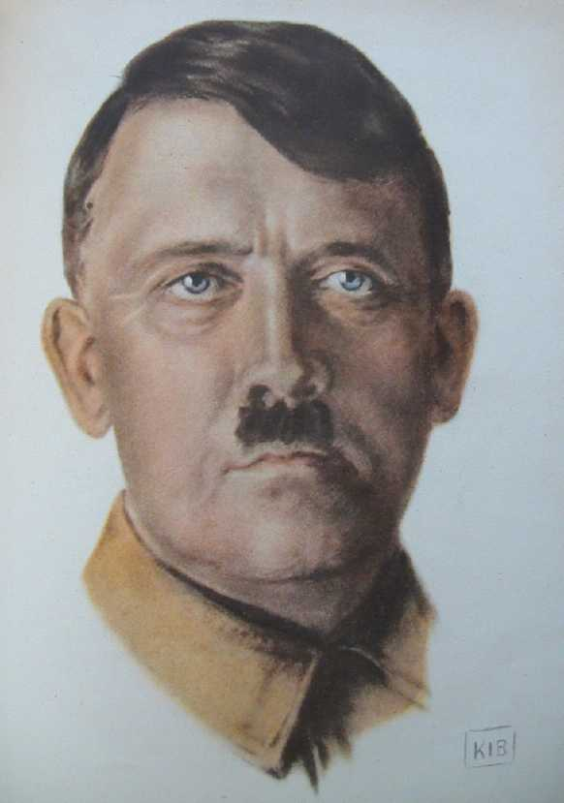
This portrait by K. I. Böhringer is taken from the September 1936 issue of Der Schulungsbrief, the Nazi monthly for political education.

Slide 10
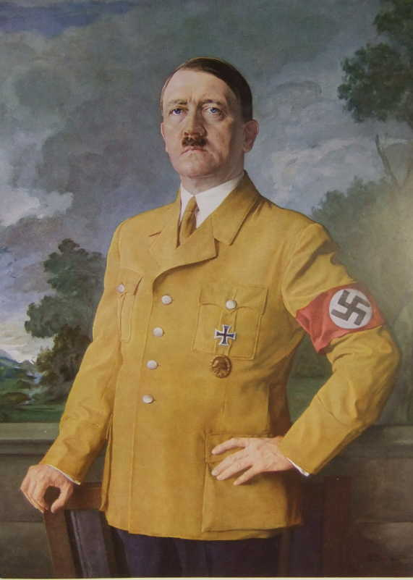
This is another portrait by Heinrich Knirr. It was on exhibit at the Greater German Art Exhibition in 1937. The image comes from Die Kunst im Dritten Reich, October 1937

Slide 11
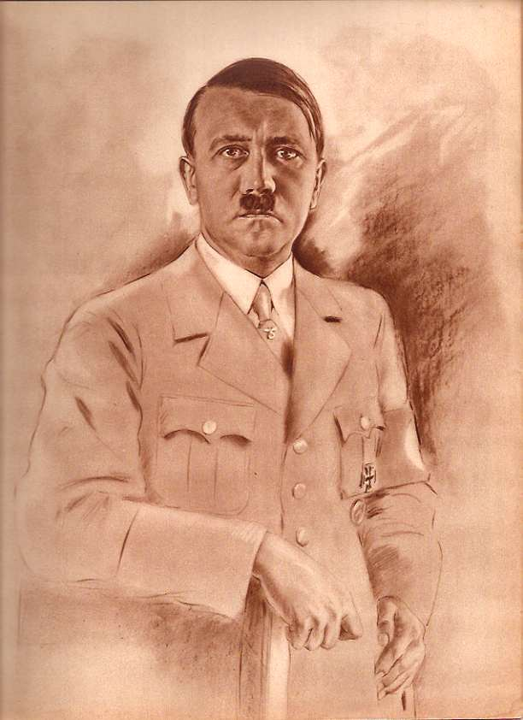
This portrait is from a 1937 issue of the Nazi women's magazine, the N.S. Frauenwarte (#22, 1936/37).

Slide 12
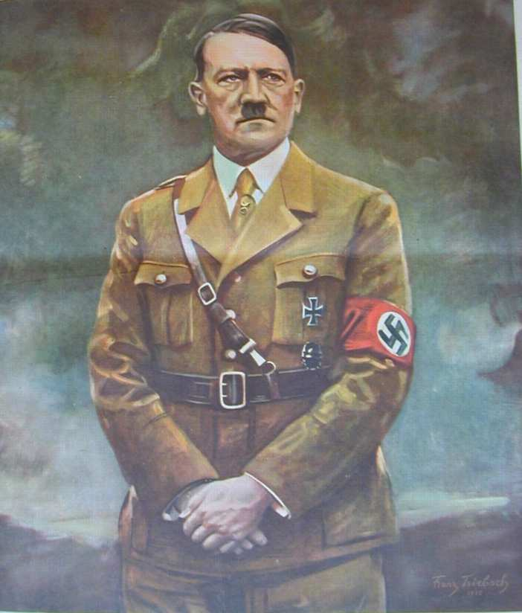
This Franz Triebsch portrait is taken from the Deutsche Illustrierte Zeitung, #16/1939.

Slide 13
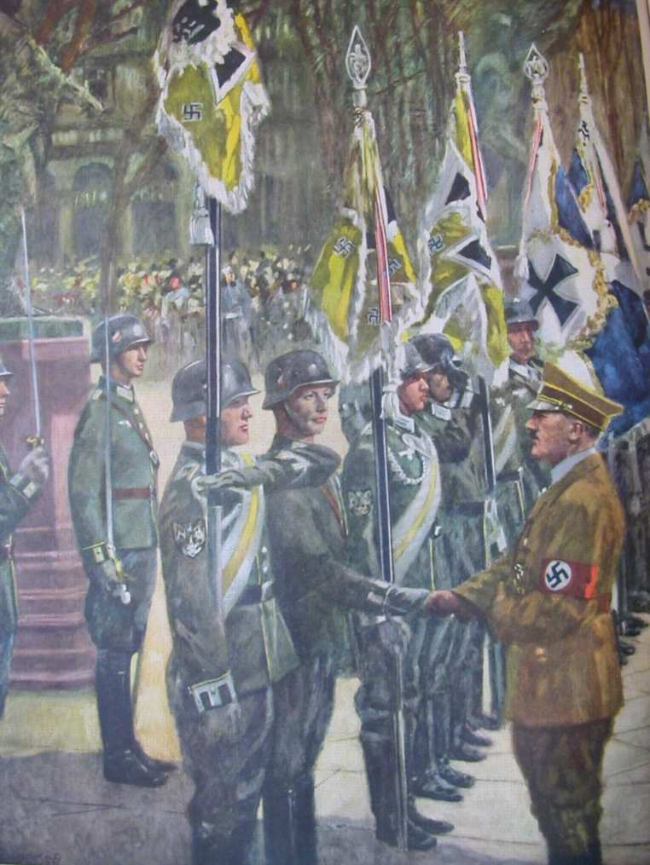
This portrait is also from the Deutsche Illustrierte Zeitung, #16/1939, by an unidentified artist. Hitler is greeting the troops.

Slide 14
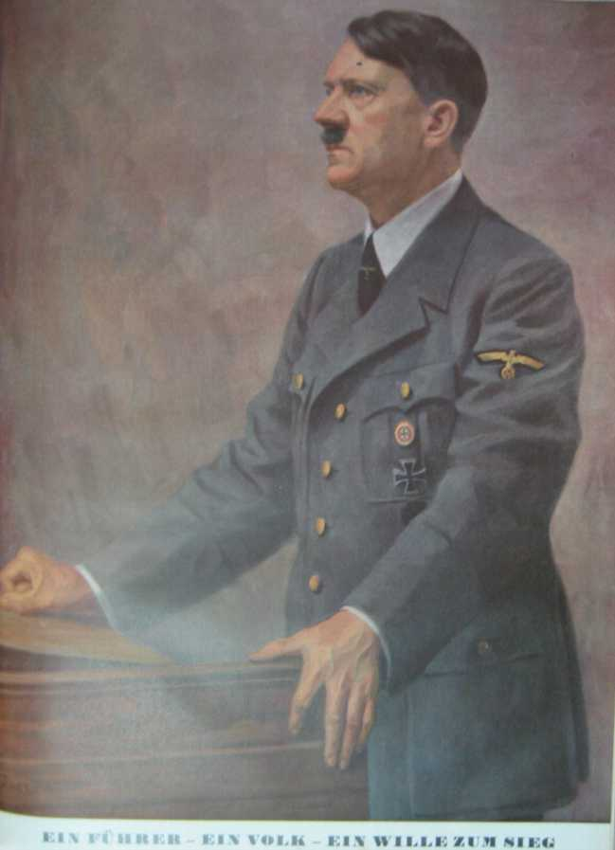
This 1940 comes from the Nazi illustrated weekly, the Illustrierter Beobachter. It was published just after the German victory in Norway. I can’t quite decipher the artist.

Slide 15
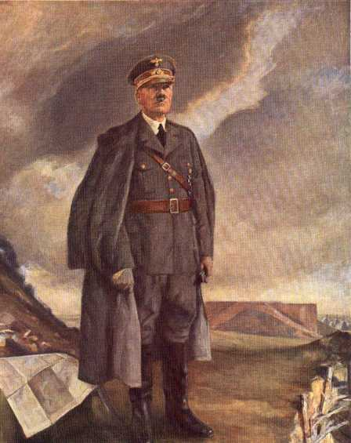
This 1940 portrait is by Conrad Hommel.

Slide 16
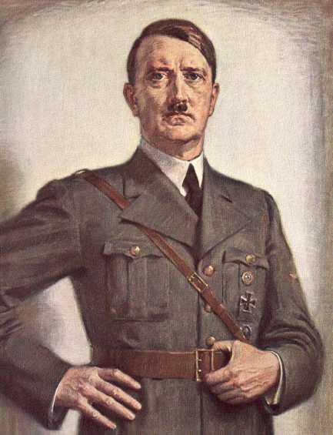
A 1941 portrait by Otto von Kursell.

Slide 17
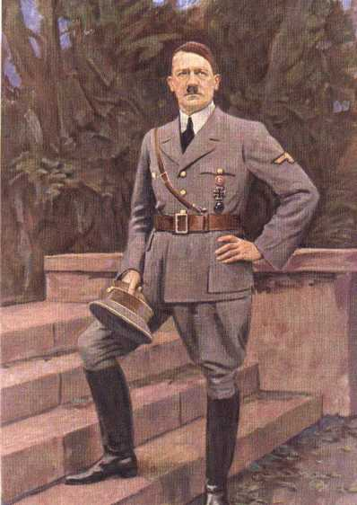
Another 1941 portrait, this one by Franz Triebsch.

Slide 18
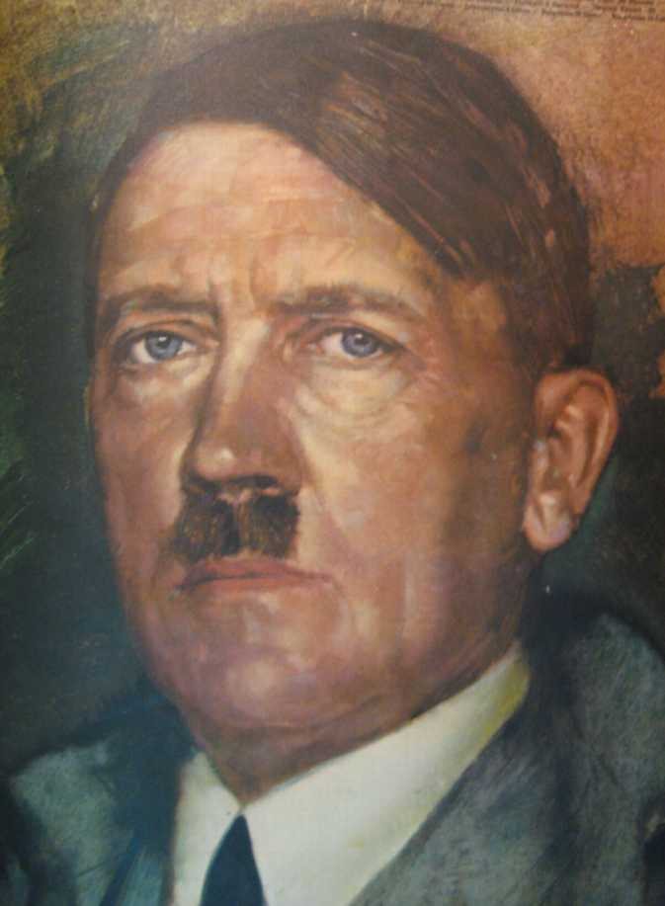
This portrait was on the cover of the Illustrierter Beobachter, #16/1941 — the issue on Hitler's birthday. No artist is given.

Slide 19
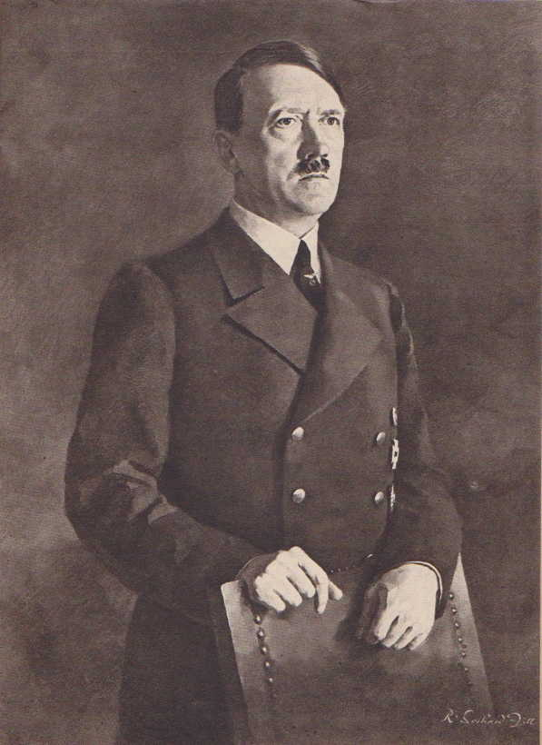
This one is from the Greater German Art Exhibition of 1942. The artist is Rudolf Gerhard Zill. The illustration is from Der Schulungsbrief (#11/12 1942).

Slide 20
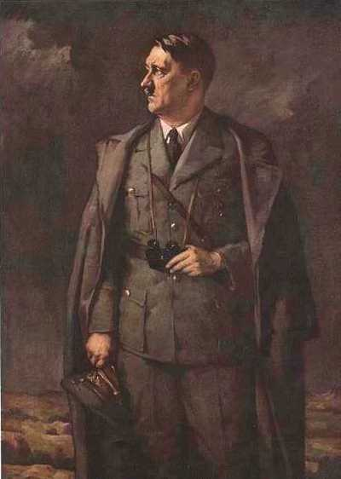
A 1942 portrait by Hans Schachinger.

Slide 21
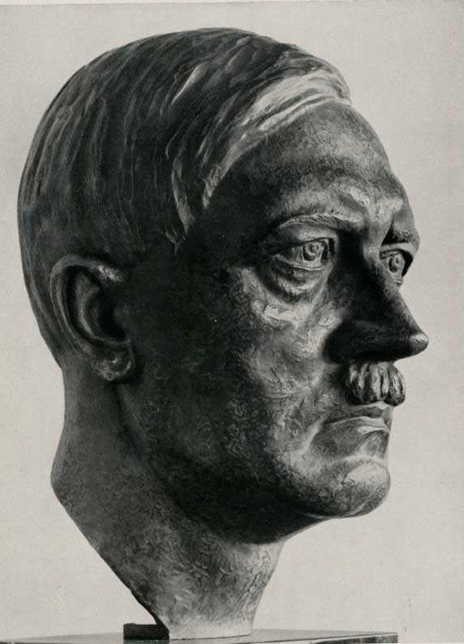
There was a major industry producing busts of Hitler. This one is by Johann Friedrich Rogge.

