Slide 1
Positives of the New Deal
People had a sense of self worth now that they had a job
Children could stay in school, now that their families had more income
Families now had some disposable income to spend, to help boost the economy
Minimum wage and better working conditions

Slide 2
Critics of the New Deal
Americans will always wait for government handouts in the future (welfare state)
The New Deal cost the government more than it was pulling in yearly (deficit spending)
Government was becoming too involved in the economy (This goes against the Free-Enterprise Capitalistic economic system)

Slide 3
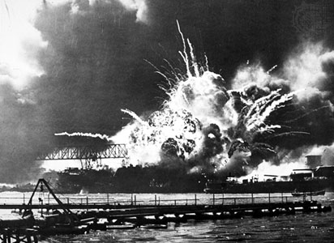
Did the New Deal Work?
It did help many Americans survive financially and literally during the Depression
The economy, however, would not fully recover until the United Stated entered WWII.

