Slide 1
Winning the Pacific

Slide 2
Bushido!
Japanese style of fighting to the death.
Do not give up under any circumstance

Slide 3
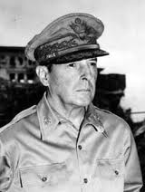
Philippines Fall
After Pearl Harbor Japan takes over Philippine Islands
Defeated General Douglas MacArthur-”I shall return”

Slide 4
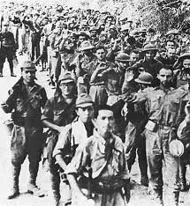
Bataan Death March
Japan made the POW’s march 60 miles in the excruciating heat
76,000 started only 54,000 made it

Slide 5
American Battle Strategy
Island Hopping-target specific Pacific Islands to invade
Defeat the Japanese and set up airstrips to help secure more islands
The goal is to get close enough to bomb the mainland of Japan

Slide 7
Key U.S. Victories
Coral Sea-May 1942 (First major victory)
Midway June 1942 (4 Japanese Aircraft carriers destroyed
Guadalcanal-Aug 42-Feb 43 (some of the bloodiest battles in the Pacific
Guam-June 1944 (Can now bomb Japan)
Leyte Gulf- Oct 1944 (MacArthur returns to free POWs

Slide 8
Iwo Jima
Feb 1945
750 Miles from Tokyo
Lasted 6 weeks (bushido)
Several thousand U.S died, 20,000 Japanese
U.S. Marines put flag atop Mt. Suribachi as symbol of victory

Slide 9
Okinawa
April 1 1945-largest land force in Pacific History
350 Miles away from Japan
Japan uses 350 kamikaze planes
“Bloodiest battle in the Pacific
49,000 U.S. Killed or wounded
100,000 Japanese died

Slide 10
Truman becomes President April 12, 1945

Slide 11
Decision Time for Truman
Once Iwo Jima and Okinawa were secured the U.S. continued constant bombings of Japan
Japanese would still not surrender
Meanwhile he was clued in on the Manhattan Project-code name for atomic bomb
July 16, 1945-bomb was successfully tried in desert of New Mexico
Potsdam Conference July 17, 1945-Allied leaders meet in Berlin and confident Truman demands unconditional surrender from Japan
They refuse

Slide 12
Military Options
Invade Japan by land-estimated ran as high as 1 million U.S. soldiers would be killed. (2-3 times as many for Japan including civilians)
Drop the Atomic Bomb-no real way of knowing the long term ramifications

Slide 13
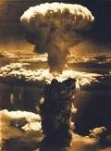
Why the Bomb?
Truman decided to drop the bomb to save lives on both sides and many believe to show the Soviets we indeed had the bomb

Slide 14
Atomic Bomb Targets
Hiroshima
Paul Tibbets drops “little boy” from the Enola Gay on Aug 6 1945
75,000 people died
Countless birth defects and other environmental hazards for decades

Slide 15
Atomic Bomb Targets
Nagasaki
August 9, 1945
“Fat man” is dropped
200,000 died
Soviet Union was now invading Japan as well

Slide 16
Japanese Surrender
Japanese Emperor calls for surrender.
Official surrender signed on Sept 2, 1945 aboard the USS Missouri in Tokyo Bay

Slide 17
WWII Impact
50 million people died
The war cost more than $1 trillion
The Soviet Union and the United States are left standing as the world’s two “Superpowers”
Over the next 4 decades the two will fight a “Cold War” to determine who will be THE Superpower of the world.

