Slide 1
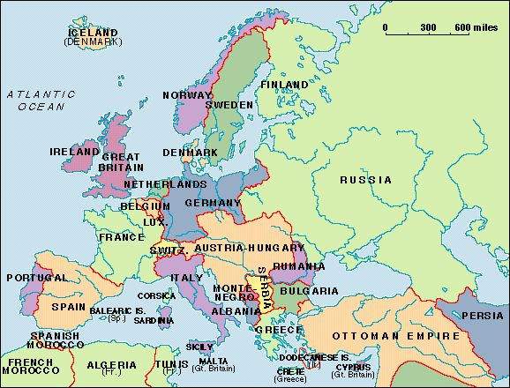
Long Term Causes of the Great War

Slide 2
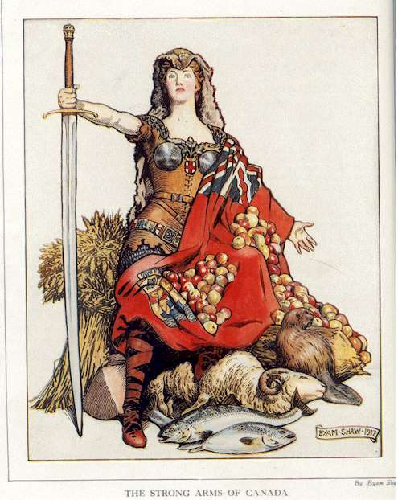
Nationalism
A feeling of intense loyalty to one’s country or group.

Slide 3
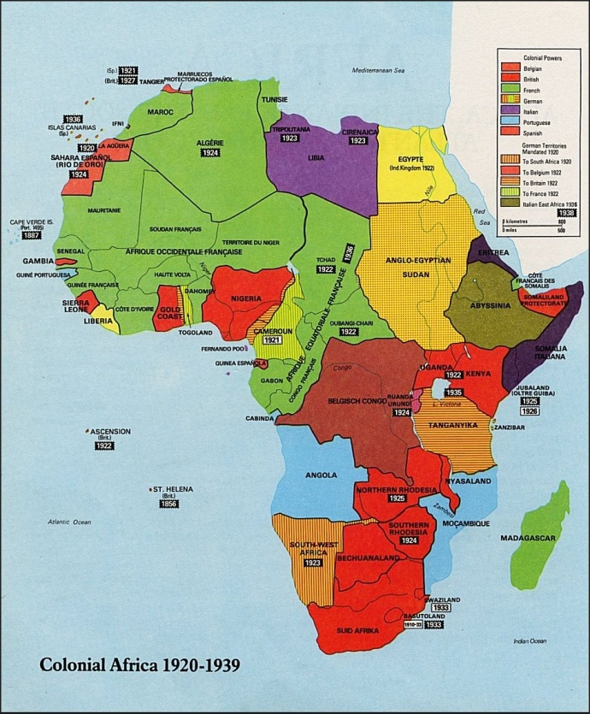
Imperialism
Imperialism caused tension with many countries in Europe as they competed for new territories to expand their borders.

Slide 4
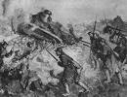
Militarism
European countries at this time created large militaries in part to keep up with their enemy countries.

Slide 5
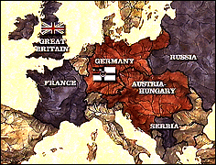
Alliance System
Countries began to choose sides to help defend one another from an enemy attack. Many of the alliances were based on common ethnic groups or a common hatred of another country.

